Slide 1
Mastering Data Analytics: A Journey to Insights
A Presentation for My Mradula Di
By Jolly Gupta
14 Sep 2023

Slide 2
Agenda
Overview of the presentation's main topics.

Slide 3
Introduction to Data Analytics
Definition and importance of data analytics:
Data analytics involves the process of examining, cleaning, transforming, and interpreting data to discover meaningful insights and support decision making.
It plays a crucial role in guiding business strategies and operations.
The role of a data analyst in an organization:
Data analysts are responsible for collecting and analyzing data, providing insights, and helping organizations make data driven decisions.
They bridge the gap between raw data and actionable insights.

Slide 4
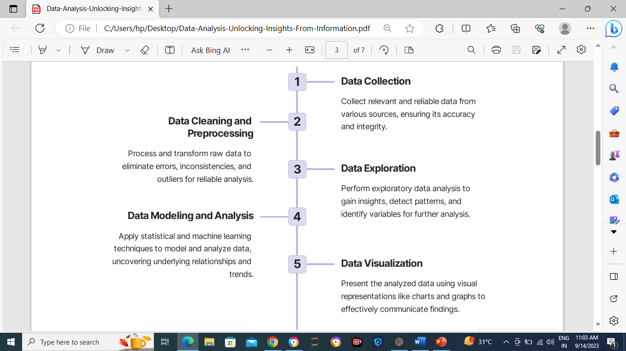
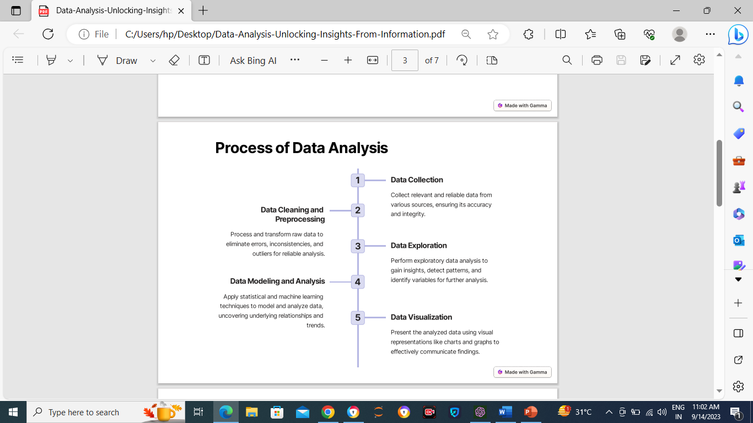
Data Analytics Process
Overview of the data analytics workflow:
Data Collection: Gathering data from various sources.
Data Preparation: Cleaning, transforming, and organizing data.
Data Analysis: Applying statistical methods, algorithms, and tools.
Data Interpretation: Extracting meaningful insights.
Highlight the iterative nature of the process and the importance of data quality
Overview of the data analytics workflow:
Data Collection: Gathering data from various sources.
Data Preparation: Cleaning, transforming, and organizing data.
Data Analysis: Applying statistical methods, algorithms, and tools.
Data Interpretation: Extracting meaningful insights.
Highlight the iterative nature of the process and the importance of data quality

Slide 5
Types of Data Analytics
Descriptive, Diagnostic, Predictive, and Prescriptive analytics:
Descriptive Analytics: Summarizes historical data. Sales reports.
Diagnostic Analytics: Identifies the reasons behind past events. Root cause analysis
Predictive Analytics: Forecasts future outcomes. Demand forecasting
Prescriptive Analytics: Recommends actions to achieve desired outcomes. Supply chain optimization

Slide 6
Data Sources Different data sources used in data analytics:
Internal sources (e.g., databases, CRM systems).
External sources (e.g., social media, public datasets).
Challenges in data collection and integration: Data quality issues, missing data, data consistency.

Slide 7
Data Cleaning and Preprocessing
The importance of data cleaning:
Clean data ensures accuracy and reliability of analyses.
Addressing duplicates, outliers, and inconsistencies. Common data preprocessing techniques: Data imputation, scaling, and normalization.
Data Analyst/scientists spend 80% of their time cleaning and manipulating data and only 20% of their time analyzing it. Data cleaning is an essential step for every Data scientist, as analyzing dirty data can lead to inaccurate conclusions.

Slide 8
Exploratory Data Analysis (EDA)
Techniques for exploring and understanding data
Data visualization: Histograms, scatter plots, box plots. Summary statistics: Mean, median, variance. EDA helps identify patterns, trends, and outliers in the data

Slide 9
Data Visualization The role of data visualization in data analytics:
Visualizations simplify complex data for easier interpretation.
Charts, graphs, and dashboards enhance data communication. Examples of effective data visualizations: Bar charts, line graphs, heatmaps, and pie charts.

Slide 10
Statistical Analysis Introduction to statistical methods
Descriptive statistics: Measures of central tendency and variability.
Inferential statistics: Hypothesis testing and confidence intervals. Hypothesis testing and significance: Testing hypotheses to draw conclusions about data. Significance levels (e.g., p-values) and confidence intervals

Slide 11
Machine Learning in Advance Data Analytics
Machine learning enables computers to continuously make predictions based on the available data without being explicitly programmed to do so. These algorithms use historical data as input to predict new output values.
Fraud Detection
Movie Recommendation System
Wine Quality Prediction
Netflix Personalization

Slide 12
Natural Language Processing
Branch of AI that helps computers interpret and manipulate natural language in the form of text and audio. :
News Translation
You can build a web application that translates news from one language to another using Python.
Autocomplete and Autocorrect
You can build a neural network in Python to autocomplete sentences and detect grammatical errors.

Slide 13
Deep Learning
Deep learning is concerned with neural networks comprising three or more layers. These artificial neural networks are inspired by the structure and function of the human brain.
Breast Cancer Classification
Image Classification
Gender and Age Detection

Slide 14
Data Analytics Tools and Software Popular data analytics tools and their features:
Python, R, Excel, Tableau, and Power BI. Highlight proficiency in relevant tools for the job

Slide 15
Top 10 Industries That Benefit Most From Data Analytics
Banking And Securities
Media & Entertainment
Pharma & Healthcare
Education
Manufacturing
Insurance
Transportation
Government
Energy & Utilities
Retail & Wholesale

Slide 16
Data Ethics and Privacy Ethical considerations in data analytics:
Ensuring data privacy and confidentiality. Responsible data handling and bias mitigation. Legal and regulatory compliance in data analysis.

Slide 17
Communicating Data Insights Effectively presenting data findings:
Storytelling with data to engage stakeholders. Creating clear and compelling data visualizations. The importance of making data driven recommendations.

Slide 18
Benefits of Data Analytics
Informed Decision Making: Data analytics enables evidence-based decision-making.
Efficiency: Identifies operational efficiencies and resource optimization opportunities.
Cost Reduction: Helps cut costs through process improvements.
Enhanced Customer Experience: Provides insights for personalized customer interactions.
Risk Management: Identifies and mitigates risks in various industries.
Predictive Analytics: Forecasts trends and outcomes based on historical data.
Healthcare: Aids in research, diagnosis, and patient care.
Education: Tailors teaching methods and tracks student performance.

Slide 19
Government: Informs policy development and resource allocation.
Manufacturing: Optimizes production processes and quality control.
Retail: Improves pricing, inventory management, and marketing.
Energy and Sustainability: Monitors energy consumption and resource management.
Financial Services: Used for fraud detection, risk assessment, and investment strategies.
Marketing: Understands consumer behavior and measures marketing success.
HR: Enhances talent acquisition, retention, and performance management.

Slide 20
Thank You Note
Thank You Express gratitude for the interviewer's time and consideration. Reiterate your enthusiasm for the role and your confidence in contributing effectively to the organization.

